Slide 1
Jordan Abbott
CS211 Text Editor project, Fall 2019, Humboldt State University

Slide 2

The coolest thing about this project (in my opinion)
The compression system implemented in Milestone 6 was pretty cool
It was my first implementation of a compression system

Slide 3
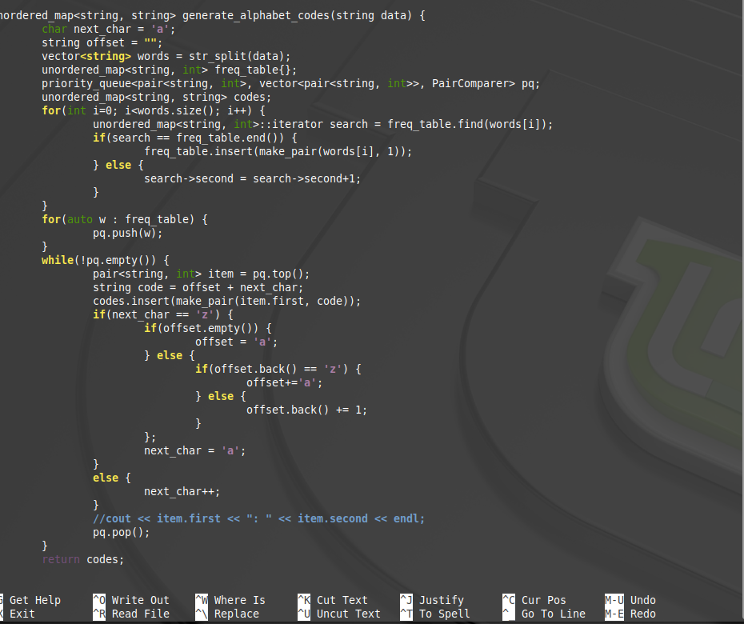
The code that I’m most proud of
Probably the code generation algorithm for the compression feature

Slide 4

If I could do it all over again, I would…
Focus more on handling the actual text, and solving these segmentation faults

Slide 5
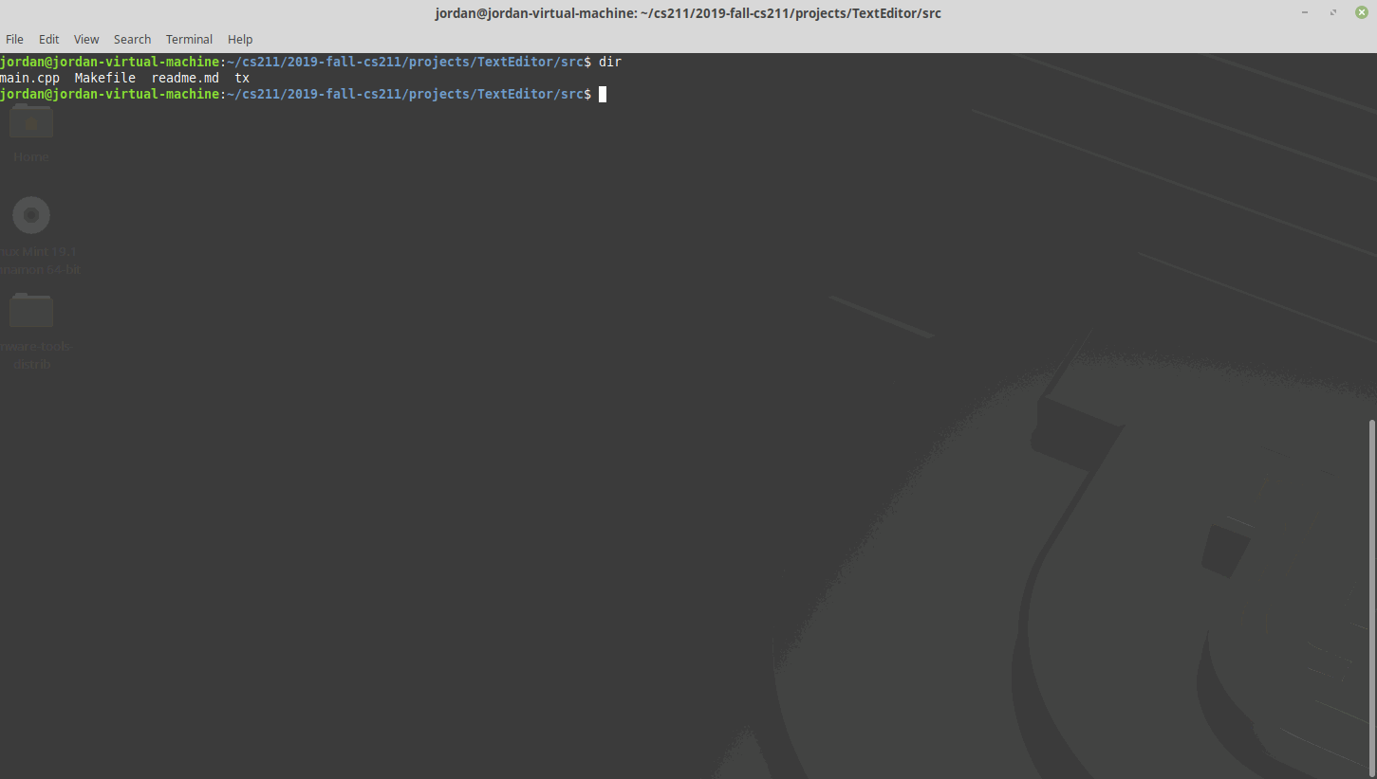
The thing that I learned the most was…
That text handling is more tricky than I initially thought. Some methods seemed to work, but not in all cases.

Slide 6
Robert Airth

Slide 7
The coolest thing about my Text Editor: I was able to make everything work and look as I initially imagined it.
I am most proud of the visual layout of my Text Editor.
I wanted it to look similar to GNU nano and DOS for simplicity of coding and usability.
I imagined the way I wanted it to look before I started programming and I was able to make my ideas come to fruition with few overall sacrifices.

Slide 8
I am most proud of the above code. This is the beginning of the code that I wrote for automatic file loading during program execution.
I had been wondering for a while how programs know which file to load during execution; I never knew how programs are made aware of external files.
I learned that files-to-be-opened are passed as arguments into the main() function.
I had trouble figuring this out at home, but I got very close to making it work before I asked my peers.
To get it working:
I learned where the executable is located in the directories
I learned that I needed to run the command prompt from the directory containing the executable.

Slide 9
If I could do it all over again, I would…
I would make better use of the Object Oriented features of C++.
I would make more methods/functions in order to reduce code duplication.
I would experiment more with curses to make better use of it.
I got to a point where allowing curses to control the cursor and handle text output ended up causing me issues, so I created my own cursor control and my own means of storing/outputting the text to the screen.
I would spend more time in the initial design phase with clear objectives to be met.
This would have helped significantly with designing appropriate classes and methods.

Slide 10
The things that I learned were…
I learned that being patient, using the web, and using the debugger can help me create or fix pretty much any issue I understand algorithmically.
I learned how to read language and library documentation.
I learned how to use the debugger and the power of each debugging feature.
I learned how to use Visual Studio and GitHub competently enough that I seldom made the same mistakes twice.

Slide 11
Grayson Beckert
CS 211
Text Editor Project in Review

Slide 12
The Coolest Thing About My Program:
The ability to type to the screen and use it as a VERY basic text editor
Nicely colored
It was the biggest continuous project I’ve worked on to date
It runs!

Slide 13
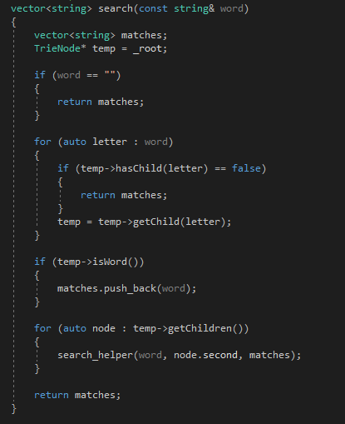
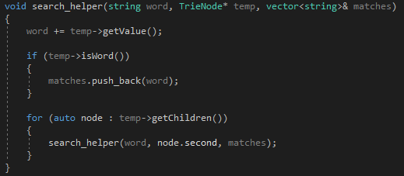
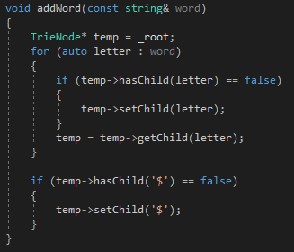
Code I’m Most Proud Of:
Milestone 5 Trie Functions
Difficult data structure to understand
This milestone was a hurdle for me, but I was happy with its outcome

Slide 14
If I could do it all over again, I would…
Start by using functions rather than converting messy code into functions later
Pay more attention to a path I wanted to take rather than figuring things out as I went

Slide 15
The thing that I learned about the most was…
Using and understanding each data structure required for each milestone
Using the debugger to my advantage

Slide 16

Brian Corbett

Slide 17
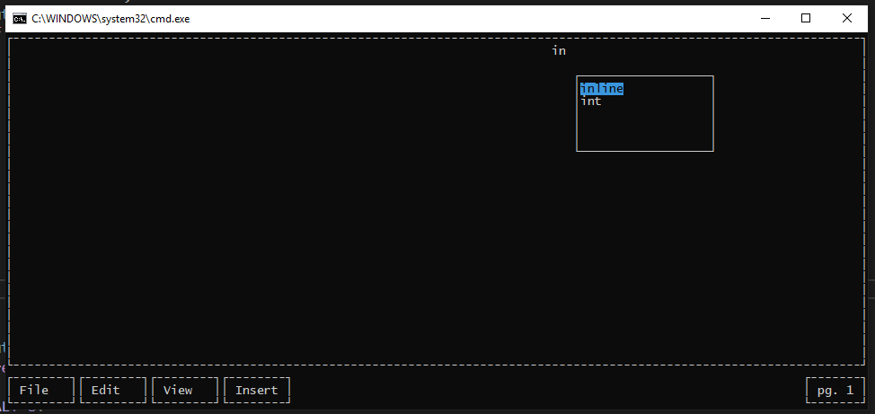
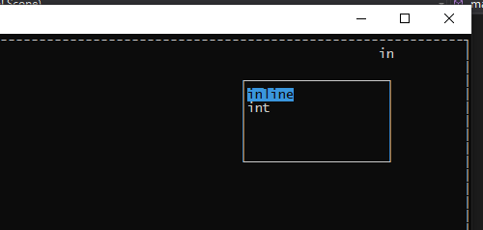
The coolest thing about the program...

Slide 18
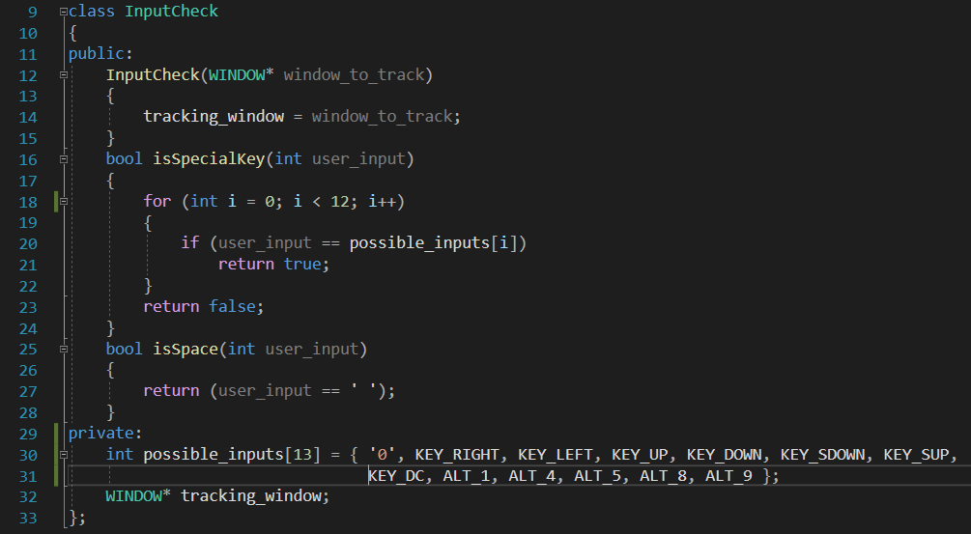
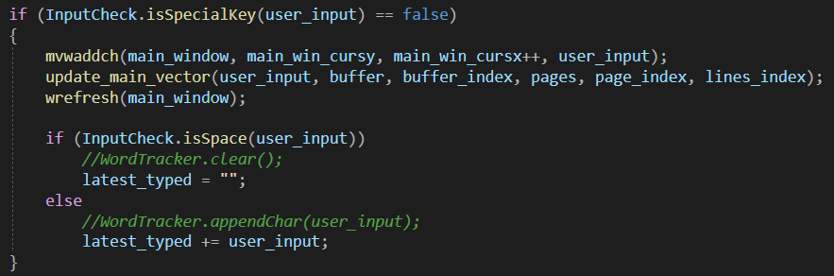
The code I’m most proud of...

Slide 19
If I could do it all over again, I would…
Now knowing what I know about ncurses and how it works (and how messy it can be), I would put more effort in organizing the code and conceptually understanding how everything is working together. I would implement object-oriented programming.

Slide 20
The thing that I learned the most was…
A very practical way that many data structures are used. Since it was so practical, and that I made something actually semi-functional, I think I will retain the concepts much more. Also how important they are to making more complex applications.

Slide 21
Fernando Crespo
Text Editor Project

Slide 22
The coolest thing about my project
The coolest part about my program is that It runs!
All the different kind of data structures that I used and their implementation to my project
It has a very simple interface

Slide 23
code that I am most proud of
I am most proud of completing the Trie data structure I however did not finish implementing it to my text editor. I was always curious how autocorrect was made when it first came out.
I also used different kinds of data structures and algorithms that I did not know about in the beginning of the semester.
I am proud that I did not quit even when some milestone were tough

Slide 24
If I could do it all over again, I would…
Set aside more time to finish and do the assignments properly. I had a tough time keeping up with the milestones
Study the data structures more
Learn how to write elegant code because my code seemed to be all over the place
Get familiar with github a lot more, I had no clue what I as doing with github and always forgot to check in github

Slide 25
The thing that I learned the most was…
I learned a lot of new data structures that are very helpful and will definitely use in the future
I learned that I need to have better time management between my classes, work, and my spare time
I learned how to modify certain data structures to make them fit the criteria that is required
Learned how autocomplete works!

Slide 26
Additional Comments
Getting familiar with the curses library was very challenging
Got more comfortable changing a certain data structure to meet the criteria that best suits the program
Although this project was tough I liked it because it gave me a little taste on how programming will be
Gained a lot of information when it comes to data structures and how to approach a computing problem
I will most likely continue on this project in the future and finish the past milestones and add more to my liking

Slide 27
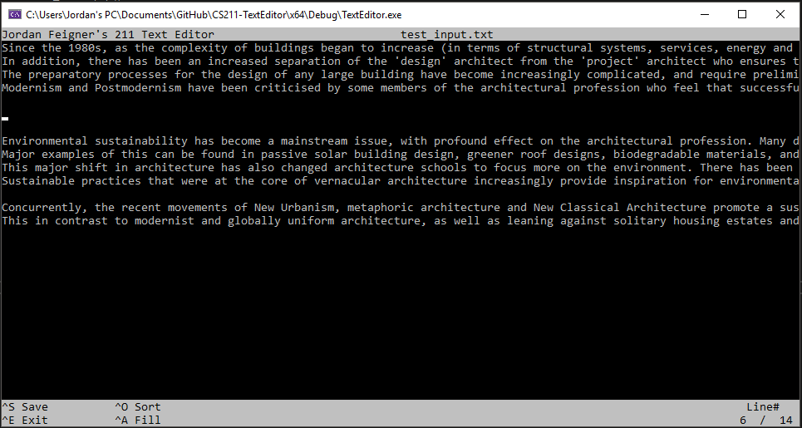
Jordan Feigner
CS 211 Text Editor Project

Slide 28
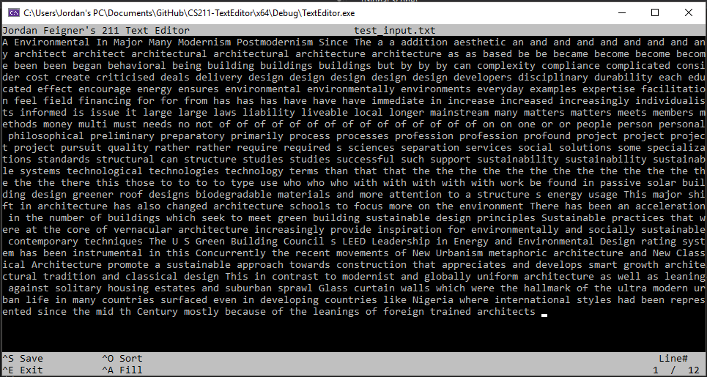
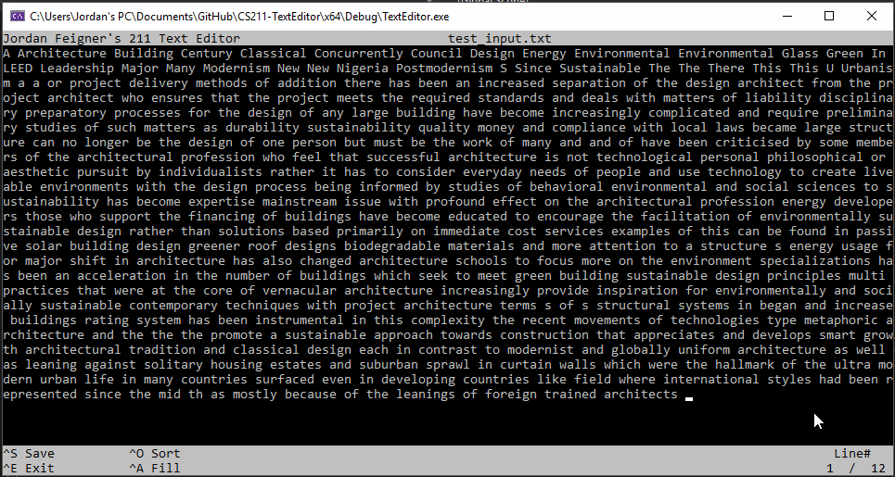
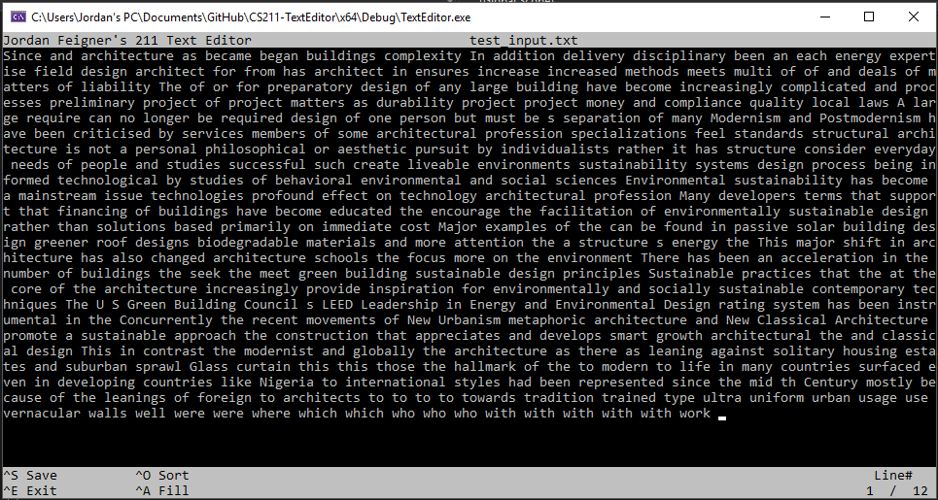
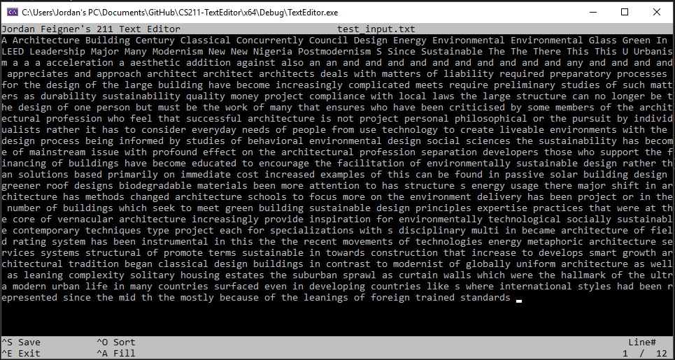
Coolest Thing: Sorting Animations

Slide 29
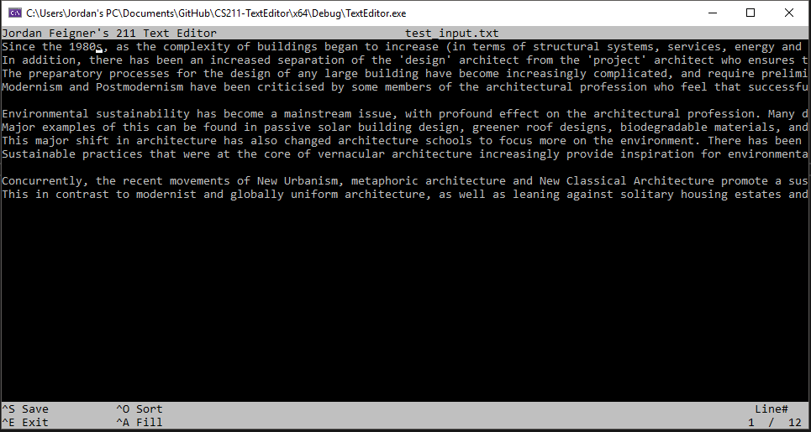
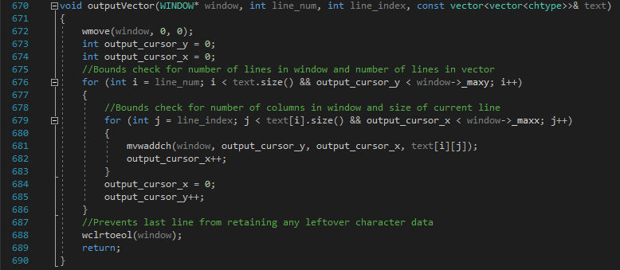
Text Output Function

Slide 30
If I could do it all over again…
I would have built from the ground up with and object-oriented programming perspective.
Kept my code cleaner.
Made my code easier to maintain.

Slide 31
Things I’ve Learned
It’s nice to have visual feedback.
Projects get very big very fast.
Large projects are not as intimidating as they first appear.

Slide 32
Silvestre Flores
CS 211 Text Editor

Slide 33
Program allows for text editing and file writing.
Edit Text
Backspace
Jump to next line
Control Z to save and exit

Slide 34
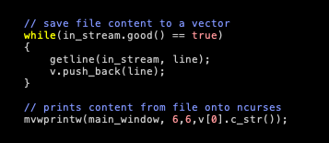
Favorite piece of code
Reads content from a file using getline()
Saves content to a vector
And then displays the content on nCurses

Slide 35
If I could do it all over again, I would…
Not have used getstr()
Dedicate more time
Do it all over again

Slide 36
The thing that I learned the most was…
It is important to think about the design of the program before jumping into writing code.
Having a poorly designed program really makes adding new features more difficult.

Slide 37
Favorite data structure
Tries
Learning about tries allowed me see the way data structures are used to implement commonly used features such as autocomplete.

Slide 38
Matthew Nicholson
Text Editor Retrospective

Slide 39

Parts of the text editor I’m most proud of:
UI design idea
Getting the search and add word functions working, and sort-of implemented into ncurses
Getting typing in the text editor working (sort-of)

Slide 40
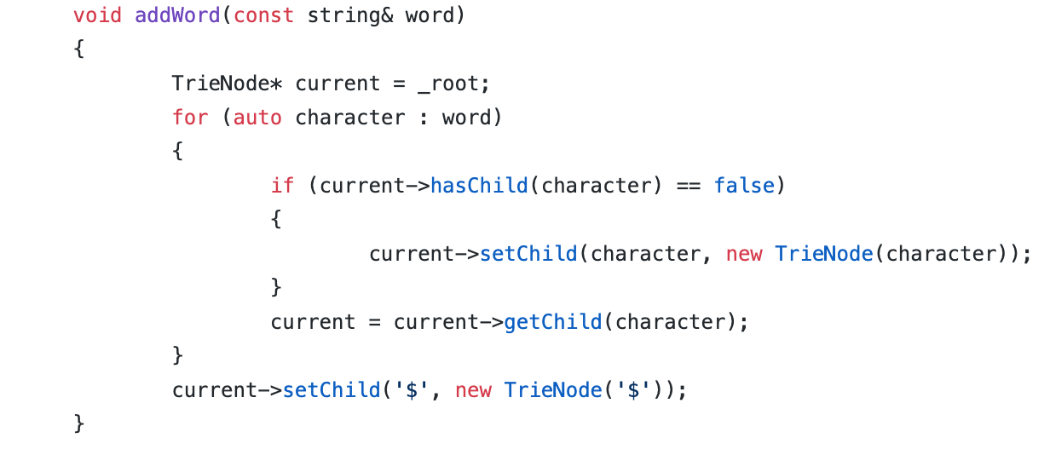
This is the code I was most proud of…
From the Trie Header file:

Slide 41
If I could do it all over again, I would…
not overbook myself with too many other projects outside of school
1
Set aside more dedicated time each week to work on the text editor besides just on Friday’s lab time
2
Ask for help sooner than later
3

Slide 42
The thing that I learned the most was…
Learning how to Google problems when troubleshooting…
Learning how to use the debugger in Visual Studio (sort-of)

Slide 43
Peter Oliver

Slide 44
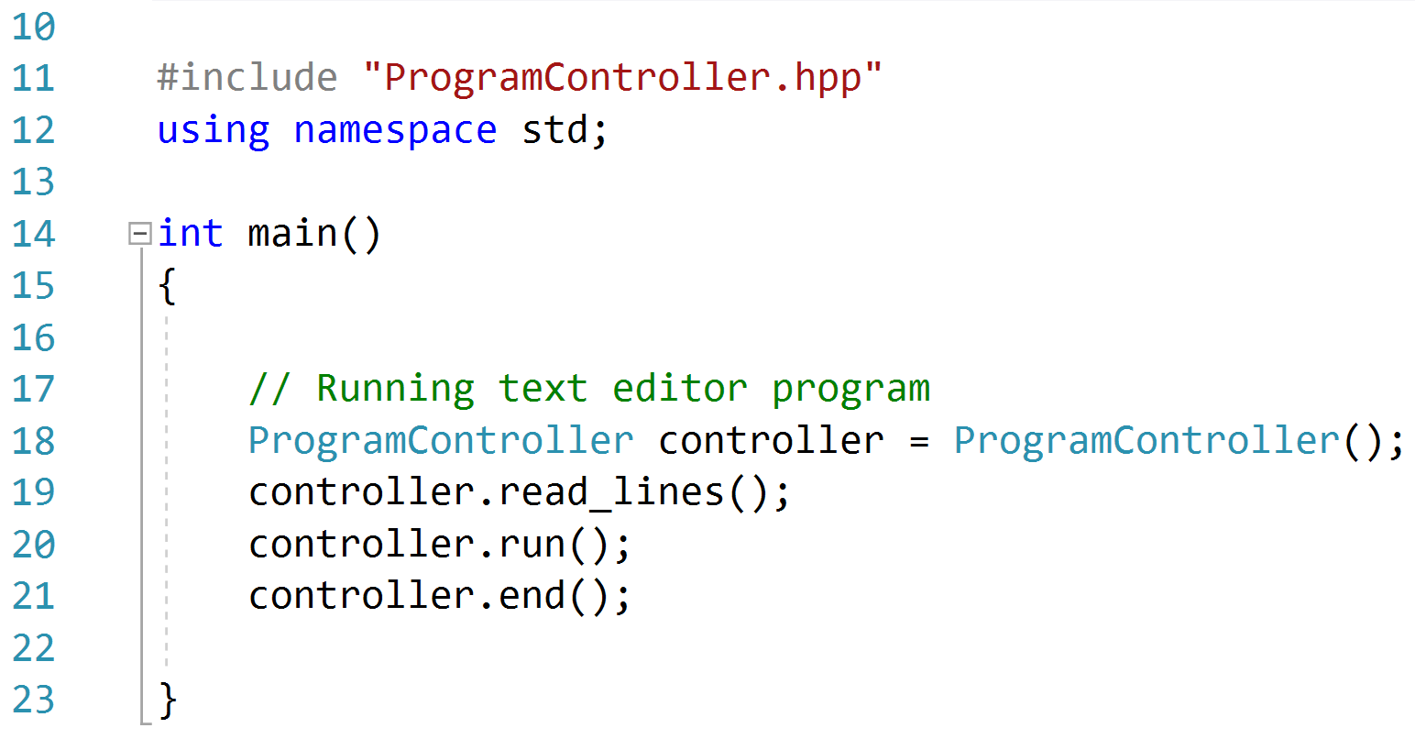

Slide 45
Main
StaticText
TextWidget
LineText
DisplayWidget
TextWindow
WindowWidget
OptionSelect Window
ProgramController
TrieTree Classes
FileController
HuffTree Classes
Sorter Classes

Slide 46
If I could do it all over again, I would …
… spend more time planning out the organization of my program.

Slide 47
The things I learned the most are …
… what it is like to work on a program for more than a week.
… how important program design is in avoiding future frustration.

Slide 48
Javon Patterson
The Text Editor That Took Over the World

Slide 49
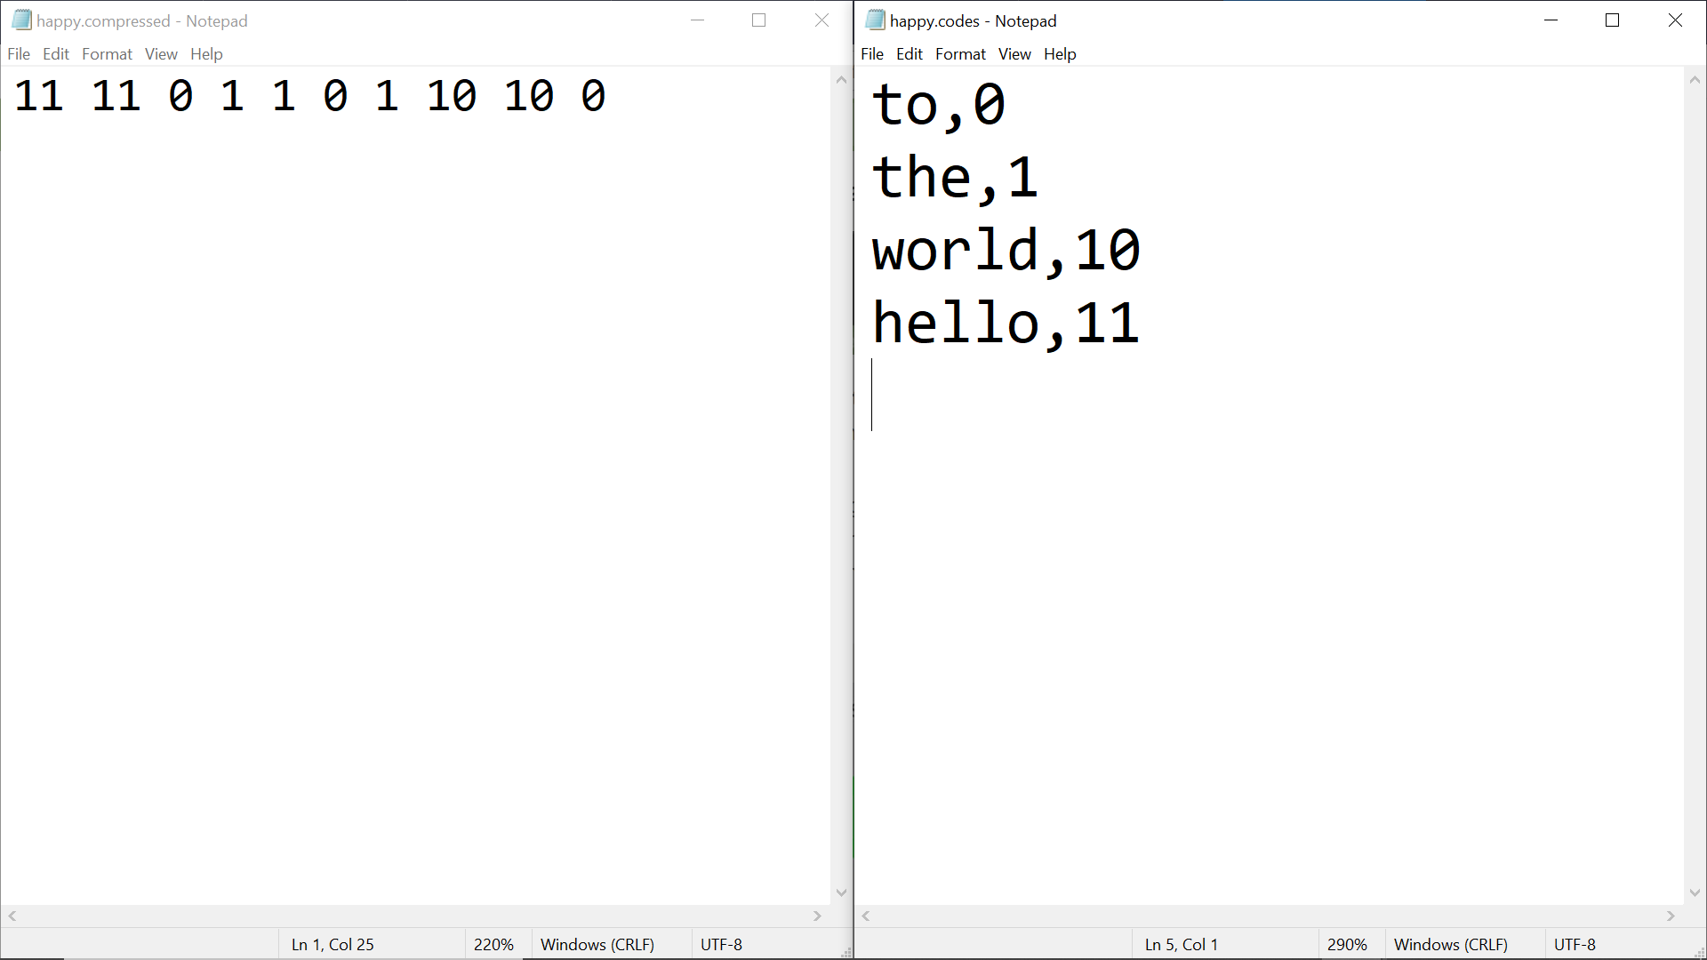
Saving in a compressed format
I think the coolest thing about my program is the ability to save text into a compressed format, along with the key for said compression
An example from my program:

Slide 50
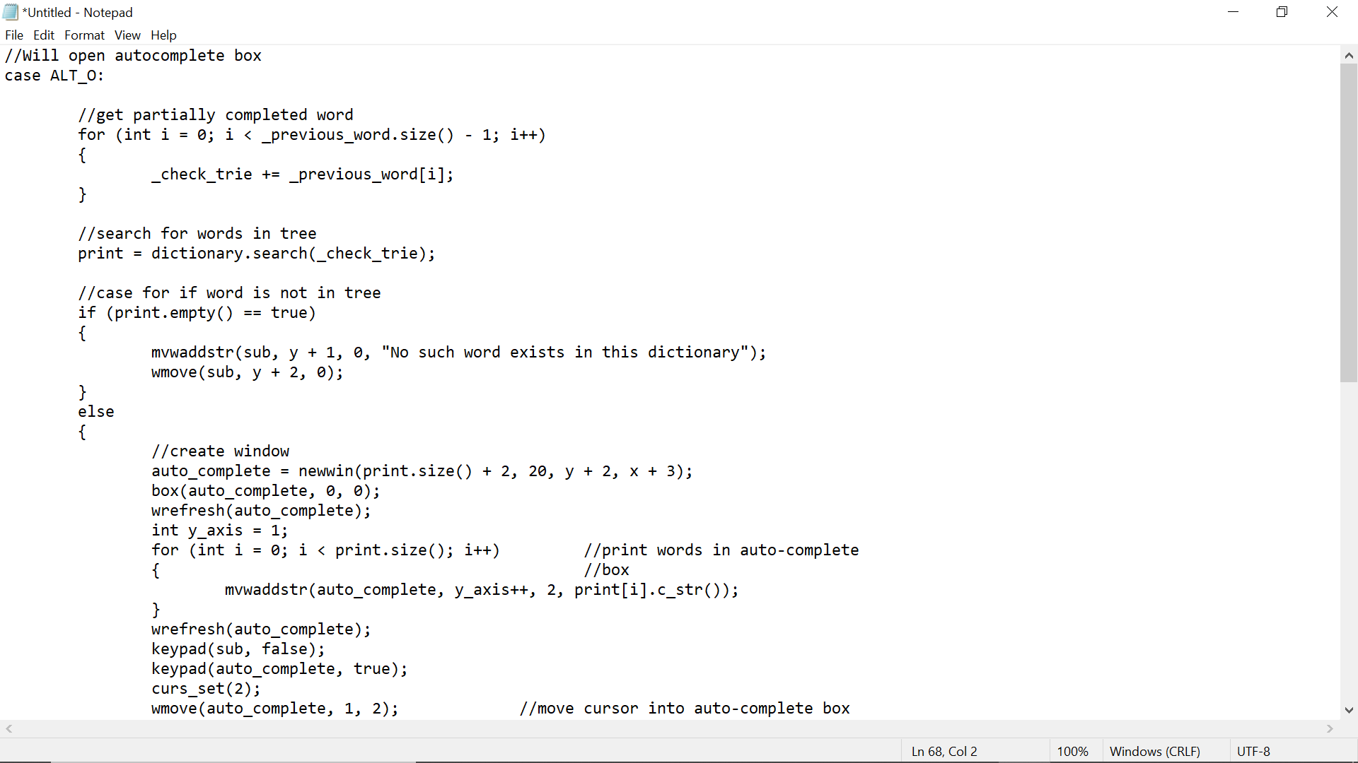
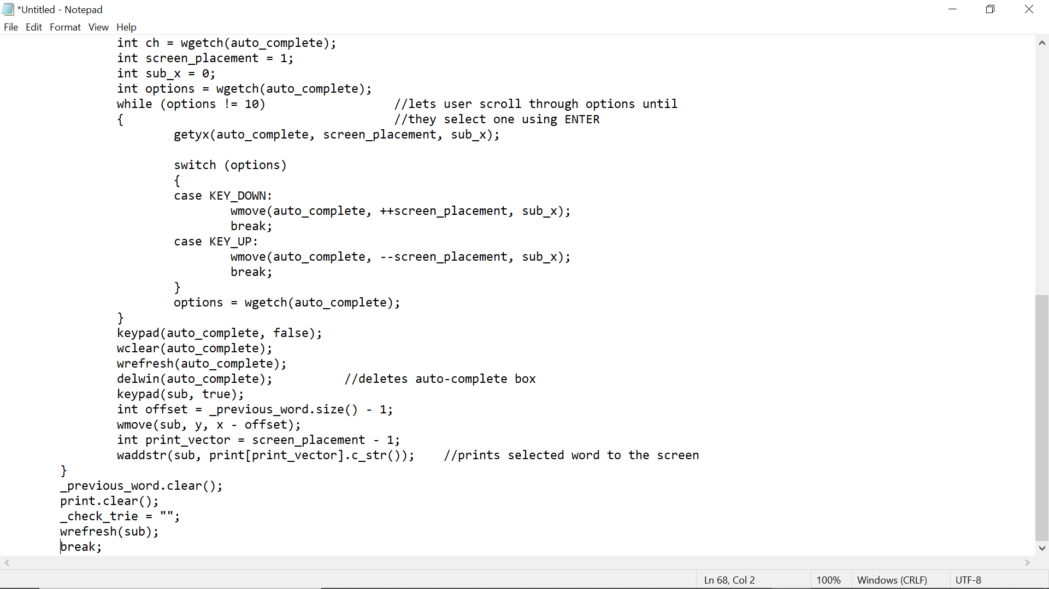
Auto-complete Box

Slide 51
If I could do it all over again, I would…
Refactor the typing and milestones so that I would have to create less vectors
Make a more generalized 2d vector

Slide 52
The thing that I learned the most was…
How to use visual studios
Familiarizing myself with visual studio's debugger

Slide 53
James Pelligra
CS 211 Text Editor Project

Slide 54
The coolest thing about my text editor is...
My text editor can write text, increment new lines, and exit the program. It is color coded with school colors.
It then automatically outputs the text to an output text file.
There is a menu with minimal interaction atm.

Slide 55
Code I am most proud of is...
The code I am most impressed with is the trie tree milestone I was able to complete. Whilst I still haven’t finished implementing the tree into my text editor, it was the most challenging part of the project for me.

Slide 56
If I could do it all over again, I would...
Have gotten off to a better start and organized all of my code into classes and functions. At the moment, a majority of my code is listed in a single block within main.

Slide 57
The thing that I learned the most was…
I learned the key aspects of several different types of data structures, and I came away with a better understanding of data organization as a whole.

Slide 58
What I will work on next
Over the winter break I hope to organize my program into classes, improve its readability, finish some of the implementations, and experiment with a few other things in pdcurses.

Slide 59
Additional Comments
This project gave me time to get use to GitHub and Visual Studios, both of which I found to be very useful.
The text editor project also allowed me to simulate real world coding deadlines and deal with some of the pressures associated.

Slide 60
Thank you for listening.

Slide 61
Elizabeth Pineda

Slide 62
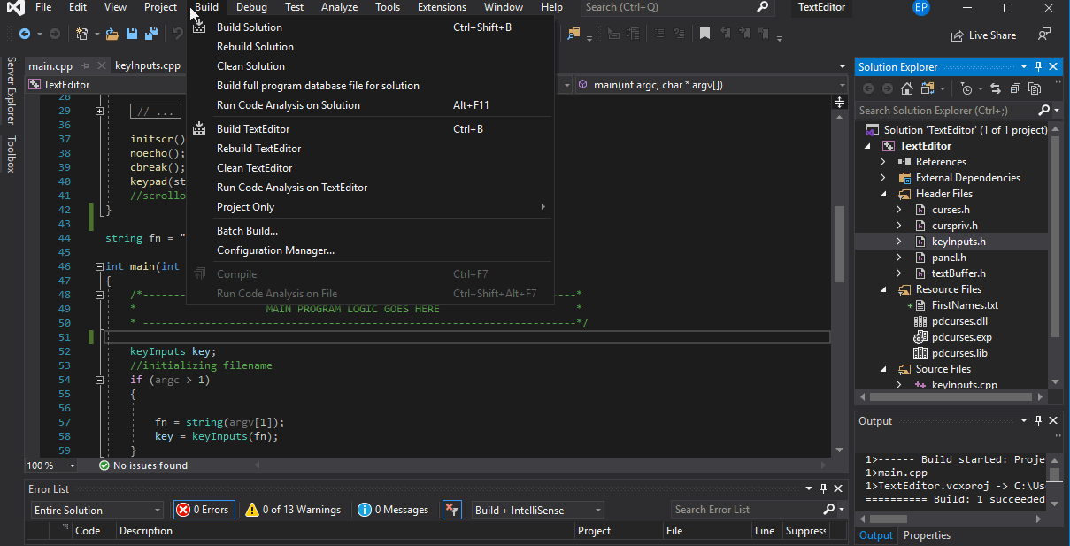
Milestone 3 – Loading and Saving a File
Notes:
Coolest part of project

Slide 63
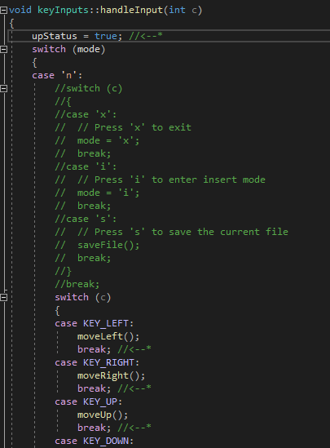
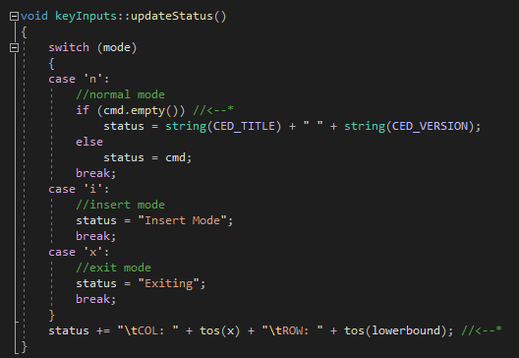
Left: handles inputs for user to use the physical keyboard, as seen in the uncommented portion Right: (was the commented portion on the left) moved to its own function
Notes:
code most proud of

Slide 64
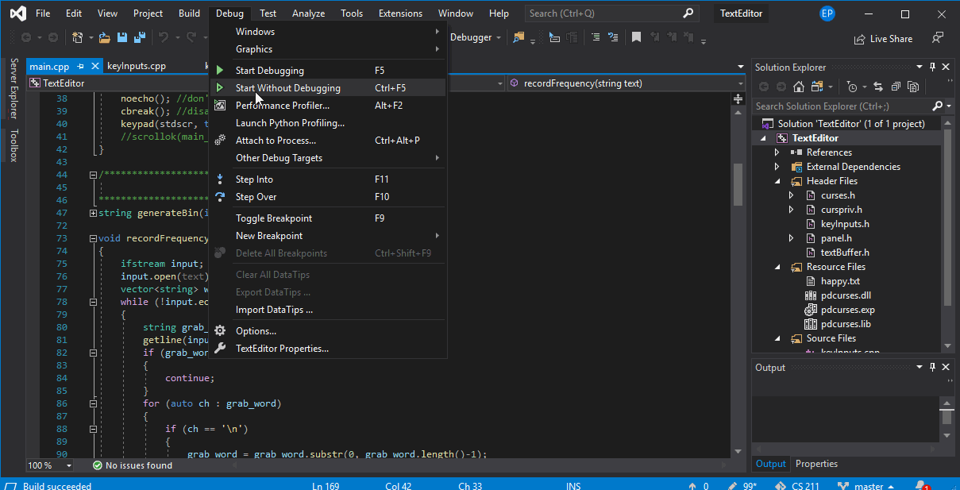
Milestone 6 – Compression Files
Notes:
Coolest part of project

Slide 65
If I could do it all over again, I would…
Be more organized with files
Have files in same destination
Read carefully
Have spent more time understanding the PD curses documentations
Also, gathering enough info from tutorials made it a bit easier to understand

Slide 66
The thing that I learned the most was…
Have multiple drafts or text editors
Even if didn’t compile, some sections of code can be useful to start new text editor
Build from most efficient text editor and continue building from there
Drawing a small sketch (wireframe) to visualize the text editor
Creating smaller functions for some portions of the code
As mentioned in the previous slide about keyInputs::handleInput and keyInputs::updateStatus

Slide 67
END
COMMENTS, QUESTIONS, OR CONCERNS ?

Slide 68
James Schulz

Slide 69
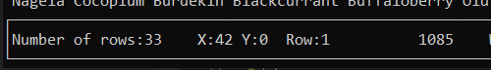
Coolest part: Counters

Slide 70
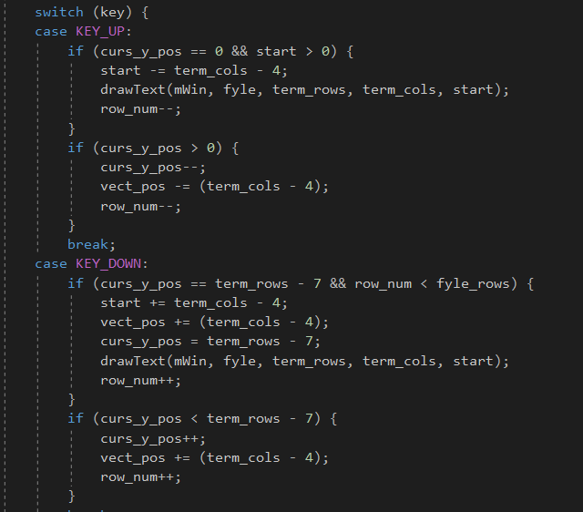
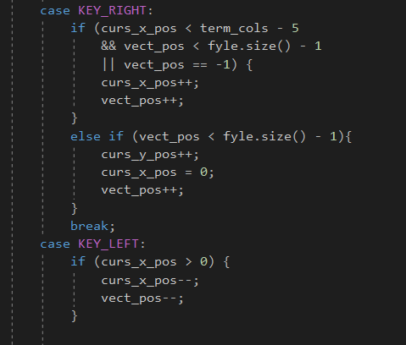
Most proud of getting keyboard input and scrolling to work correctly

Slide 71
If I could do it all over again, I would… 1. Separate program into sub-files to make navigating through the program easier 2. Have a plan before starting

Slide 72
The thing that I learned the most was… Trying to plan for the future is very difficult, but not planning ahead can make your life really difficult

Slide 73
April Thompson

Slide 74
Coolest thing about my program:
Saving
Save timestamp
Keyboard Input
Sorting

Slide 75
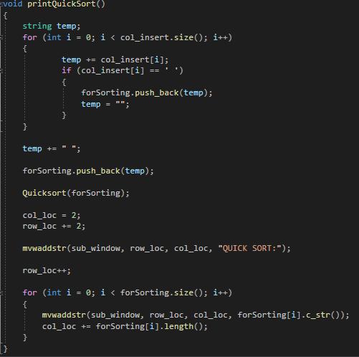
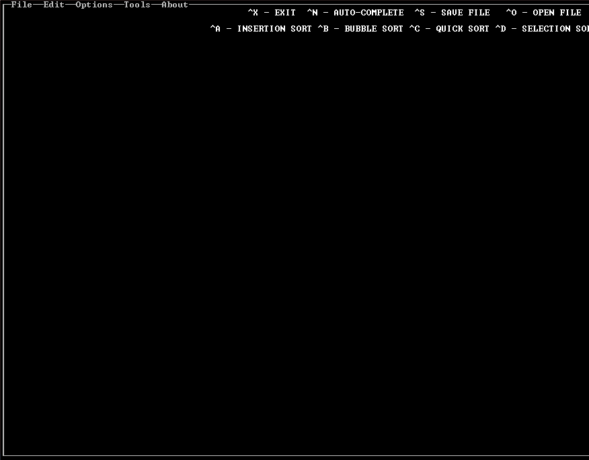
I’m most proud of:

Slide 76
If I could do this project all over again I would:
Prioritize organization in code
Plan features in advance
Consider variable compatibility based on features
Refactor often

Slide 77
The thing I that I learned the most was…
Importance of planning before coding
Importance of organization as program increases in size

Slide 78
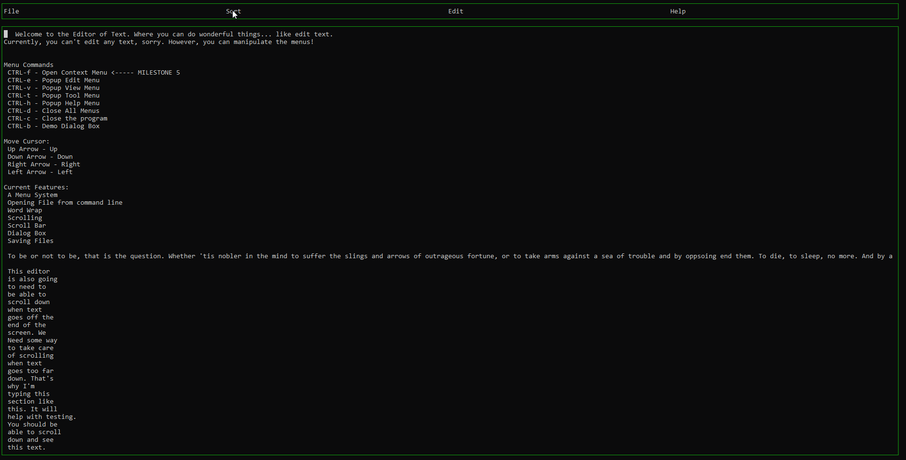
Isaac Travers – CS211 Text Editor

Slide 79
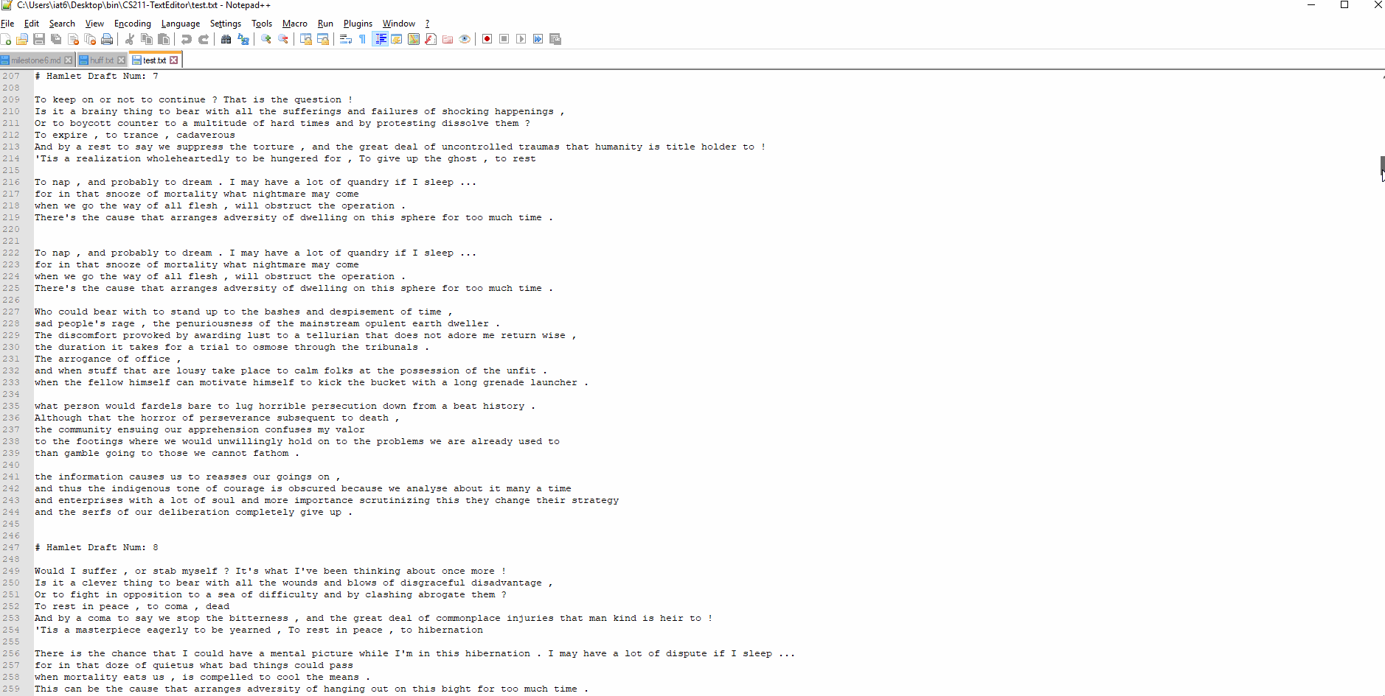
I’m most proud of: Actual Huffman Compression

Slide 80
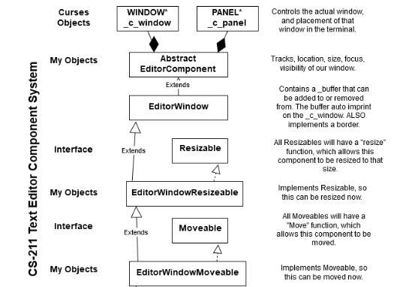
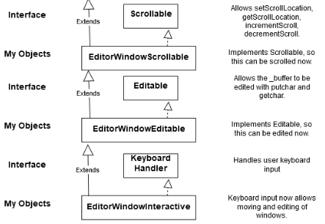
I’m most impressed with my Object Model

Slide 81
If I could do it all over again, I would…
Revamp My Object Model to favor composition over inheritance.
Creating all my objects via inheritance makes it hard to create a new object on the fly, instead all my objects have to be designed to inherit from some other object.
Creating my objects via composition would allow be to take different components and throw them into a new object easier.
Create a functional prototype before I start heavily designing how my components are going to work together.
I was already creating my object model before really understood how the underlying CURSES library works. As a result I have several bugs in my model that are not fixable without a MAJOR refactor.

Slide 82
The thing that I learned the most was…
I felt I already had a good handle on the data structures taught in the class.
Instead I mostly focused on improving my handle of the “Object Oriented Paradigm.
I’ve always used a modified paradigm that’s not really object oriented.
My natural tendency leads to spaghetti code.
I worked hard on mastering this tendency, to only use it when it is, in fact, appropriate.
Books Read:
Data Structures & Algorithm Analysis – Clifford A. Shaffer (Course Text Book)
Design Patterns - Elements of Reusable Object Oriented Software – The Gang of Four
Head First Design Patterns – Eric Freeman & Elizabeth Freeman

Slide 83
Stats for class this semester:
Number of Hours in Class: ~75
Number of Hours on Homework: ~300
Number of Hours Reading: ~50
Misc Hours Preparing for Class: ~45
Lines of Total Code Written in ALL branches: ~7422
Lines of Code Written in Final Project: ~5781
College Savings Spent to Attend Class: $2,767. 50
Dollars Per Hour of Study: $5.89
Hours spent earning money to attend class: 235
Total Hours spent to Attend Class: 705 (17.62 Weeks of Full-time work)

